Slide 1
Inclusive Senior Education through Virtual U3A
Proposal of evaluating and disseminating activities
Project Number: 2017-1-CZ01-KA204-035438
ISEV Kick off Meeting
Ostrava, 27th-28th November 2017

Slide 2
OVERVIEW
Evaluation goals
Evaluation tools
Evaluation Outputs
Dissemination
Key concepts
Key contents
Dissemination tools & activities (partners’ tasks)
Dissemination Activity Report template
Exploitation strategy
ISEV Kick off Meeting
Ostrava, 27th-28th November 2017

Slide 3
EVALUATION GOALS
For evaluating the project activities, the following elements will be taken into account:
ISEV methodology
Courses organization
Learning and experience of beneficiaries
Didactics contents and the quality of the tools (learning materials and web platform)
Blended mobility of adult learners
Management (project meeting)
ISEV Kick off Meeting
Ostrava, 27th-28th November 2017

Slide 4
EVALUATION TOOLS
Initial questionnaire
Final questionnaire
Video interviews
Management Evaluation Survey
ISEV Kick off Meeting
Ostrava, 27th-28th November 2017

Slide 5
INITIAL QUESTIONNAIRE
The Initial questionnaire will be addressed to the seniors involved in the project and it will take into account:
Expectations regarding the project
Motivation to participate in the course/blended mobility
Incoming Skills
Expectations regarding the acquisition of ICT competences
ISEV Kick off Meeting
Ostrava, 27th-28th November 2017

Slide 6
FINAL QUESTIONNAIRE
The Final questionnaire will be addressed to the senior students, the seniors in the teachers role and the students (young people) involved in the project.
There will be also a specific section to evaluate the blended mobility.
The questionnaire will take into account:
ISEV methodology
Didactics contents and the quality of the tools (learning materials and web platform)
ICT Competences and soft skills acquired
Logistic aspects of the course organization
ISEV Kick off Meeting
Ostrava, 27th-28th November 2017

Slide 7
INITIAL AND FINAL QUESTIONNAIRE
The questionnaires will be prepared on Survey Monkey by FMD.
Each partner will be responsible for the survey responses of its participants.
The questionnaires will be in English and each partner will be able to decide how the questionnaires will be filled out (in English on survey monkey or in another language on paper).
FMD will analyse the English data on Survey Monkey.
ISEV Kick off Meeting
Ostrava, 27th-28th November 2017

Slide 8
VIDEO INTERVIEWS
Each partner will realize at least 7 video interviews:
n.2 with seniors involved in the project
n.2 with seniors in the teachers role
n.2 with students involved
n.1 with a participant during the blended mobility
The video interviews will be recorded in English or subtitled in English.
Each partner will be responsible to upload them on Youtube.
FMD will prepare a set of questions (2/3) to lead the interviews.
ISEV Kick off Meeting
Ostrava, 27th-28th November 2017

Slide 9
MANAGEMENT EVALUATION SURVEY
The Management Evaluation Survey concerns the evaluation of the project plenary meetings.
FMD will prepare the Management Evaluation Survey on Survey Monkey.
The partner responsible of the meeting organization will send the Survey link to the others and will analyze the answers preparing an Evaluation Report.
The results of the evaluation will be shared with partners through an Evaluation Report (Power Point) during the following meeting.
ISEV Kick off Meeting
Ostrava, 27th-28th November 2017

Slide 10
EVALUATION OUTPUTS
Management Evaluation Report (Power Point)
Final Evaluation Report to present the surveys results through a comparative analysis
ISEV Kick off Meeting
Ostrava, 27th-28th November 2017

Slide 11
DISSEMINATION
FMD leads the project Dissemination activities.
ALL PARTNERS are responsible to contribute to Dissemination and Exploitation activities throughout the project lifetime.
The ISEV Dissemination Plan is the tool that can guide the partners in order to disseminate project’s objectives and activities, ensure visibility on a wide scale and promote the exploitation of the project’s results.
Each partner will identify, reach and involve the project target groups and a wide range of key stakeholders interested in the project results at local, regional, national and European level.
ISEV Kick off Meeting
Ostrava, 27th-28th November 2017

Slide 12
KEY CONCEPTS
Dissemination is the process of providing information to key parties on the project results. It is related to making the project results visible to others, specially the end-users, the target groups and the key-actors that can implement its use.
Exploitation means making use of and deriving benefit from a project result. closely associated with the sustainability of the project after its conclusion, to ensure that the results of the project are used by its target groups and possibly are transferred to other contexts (e.g. other countries; other pedagogical areas, other sectors).
ISEV Kick off Meeting
Ostrava, 27th-28th November 2017

Slide 13
KEY CONCEPTS
The Dissemination Plan includes dissemination and exploitation activities to be completed during and beyond the project lifetime by all the project partners to ensure that project results are promoted and transferred to the target groups and stakeholders at local, regional, national and EU level.
Specifically, it includes:
Identification of potential end-users, target groups and key stakeholders in each project country and at EU level
Communication strategy for each project intellectual output.
Dissemination tools, activities, work plan and the Dissemination Activity Report template for partners
Exploitation strategy
ISEV Kick off Meeting
Ostrava, 27th-28th November 2017

Slide 14
DISSEMINATION TOOLS
ISEV website MULTILINGUAL STATIC CONTENTS. NEWS EN
Project partners’ websites MULTILINGUAL
Partners Social Media (Twitter, Facebook, YouTube, etc) MULTILINGUAL
Partners Newsletters and Bullettins MULTILINGUAL
ISEV Kick off Meeting
Ostrava, 27th-28th November 2017

Slide 15
DISSEMINATION ACTIVITIES
Partners’ tasks (1)
Website: send to University of Ostrava (responsible for website development and update) at least 2 NEWS every 3/4 months in English (including links, pictures, videos) related to the on-going project activities in the country, or information about relevant events, reports, conferences etc.
Facebook & Twitter: post at least 2 NEWS every 3/4 months including pictures, video, video interviews to project participants, links etc.
Newsletters and bullettins: include info about the project at least in 2/3 Newsletters per year.
ISEV Kick off Meeting
Ostrava, 27th-28th November 2017

Slide 16
DISSEMINATION ACTIVITIES
Partners’ tasks (2)
PROMOTE ISEV through partners’ website, social media, networks, blogs, news, newsletter etc.
PUBLISH news, articles, papers on different thematic portals, networks, magazines, conference proceedings etc.
LAUNCH press releases in occasion of project events; recording video/radio interviews etc.
PRESENT and promote the project at local/national/EU relevant events.
Important: REPORT YOUR DISSEMINATION ACTIVITIES every 6 months to FMD using the Dissemination Activity Report Template.
ISEV Kick off Meeting
Ostrava, 27th-28th November 2017

Slide 17
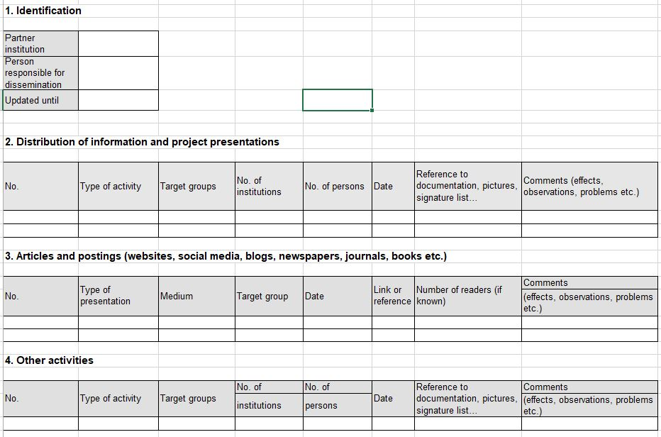
DISSEMINATION ACTIVITY REPORT
ISEV Kick off Meeting
Ostrava, 27th-28th November 2017

Slide 18
EXPLOITATION STRATEGY
Objectives
Identify local, regional, national and European stakeholders;
Reach those stakeholders and make them interested in the project's results and products;
Facilitate the further transfer of the ISEV products to other organizations and individuals active in the field or into new contexts;
Ensure the further use and sustainability of the project's results on the long-term;
Establish the necessary basis and guidelines to the future exploitation of results by other organizations.
ISEV Kick off Meeting
Ostrava, 27th-28th November 2017

Slide 19
Thanks for the attention!
ISEV Kick off Meeting
Ostrava, 27th-28th November 2017

