Slide 1
SENIOR EDUCATION -
sexta-feira, 28 de Dezembro de 2017

Slide 2
150
Total de respostas
Data da criação: sexta-feira, 28 de Dezembro de 2017
Respostas completas: 150

Slide 3
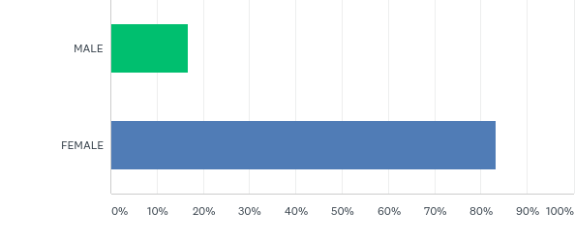
Q1: GENDER
Responderam: 150 Ignoraram: 0

Slide 4
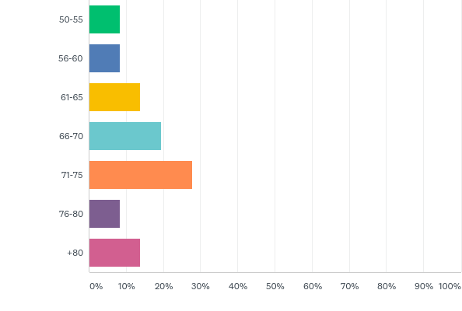
Q2: AGE
Responderam: 150 Ignoraram: 0

Slide 5
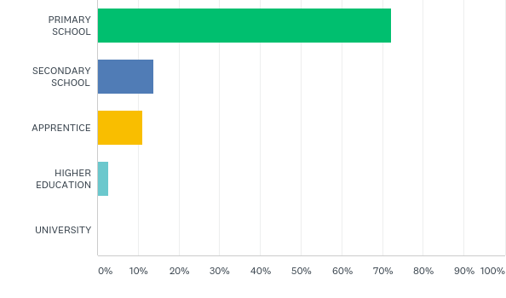
Q3: WHAT IS YOUR EDUCATION
Responderam: 150 Ignoraram: 0

Slide 6
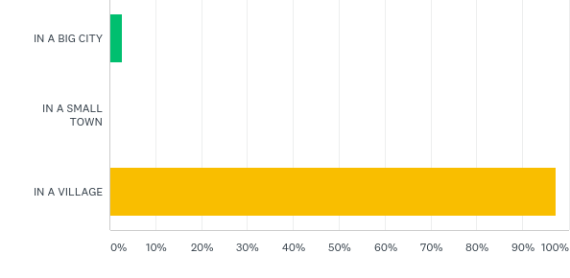
Q4: WHERE DO YOU LIVE
Responderam: 150 Ignoraram: 0

Slide 7
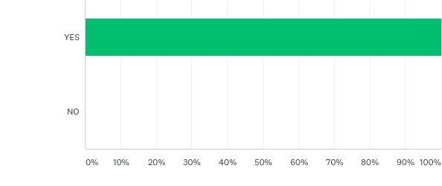
Q5: DO YOU HAVE AN OPPORTUNITY TO MEET OTHER SENIORS
Responderam: 150 Ignoraram: 0

Slide 8
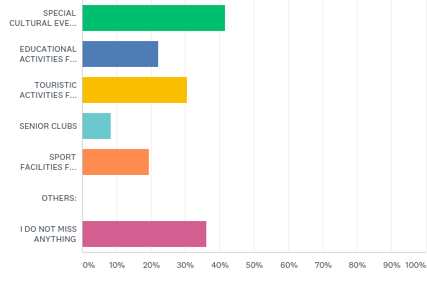
Q6: WHAT TYPE OF ACTIVITIES DO YOU MISS
Responderam: 150 Ignoraram: 0

Slide 9
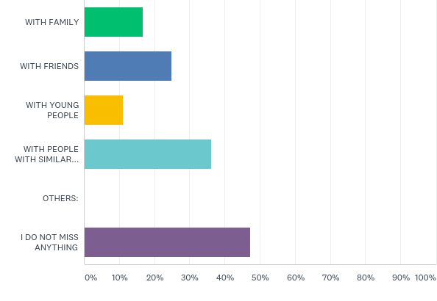
Q7: DO YOU FEEL EXCLUDED FROM THE SOCIETY? DO YOU MISS CONTACT
Responderam: 150 Ignoraram: 0

Slide 10
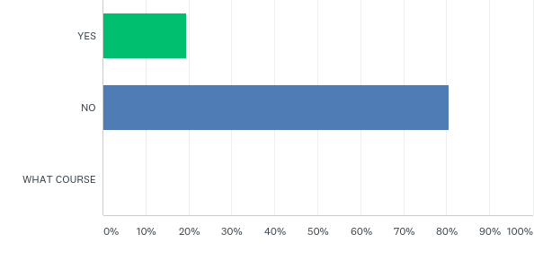
Q8: HAVE YOU EVER ATTENDED COURSE/S WHERE STUDENTS ASSISTED YOU
Responderam: 150 Ignoraram: 0

Slide 11
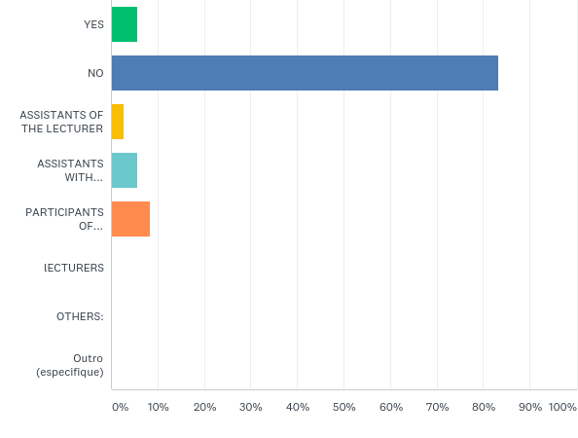
Q9: WOULD YOU PREFER A COURSE WHERE STUDENTS WOULD BE ENGAGED? IF YES, WHICH ROLE SHOULD THEY HAVE
Responderam: 150 Ignoraram: 0

Slide 12
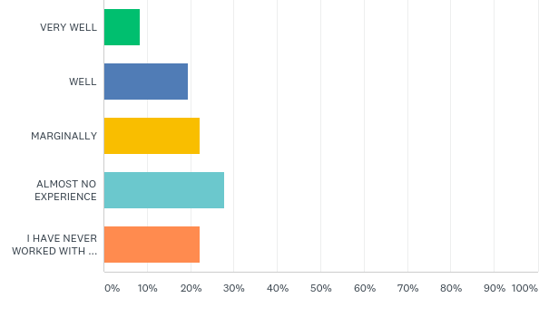
Q10: DO YOU MASTER WORK WITH A PC AND THE INTERNET
Responderam: 150 Ignoraram: 0

Slide 13
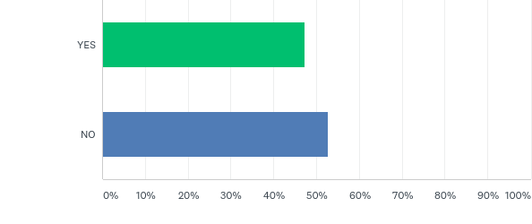
Q11: WOULD YOU LIKE TO IMPROVE YOUR WORK WITH A PC AND THE INTERNET
Responderam: 150 Ignoraram: 0

Slide 14
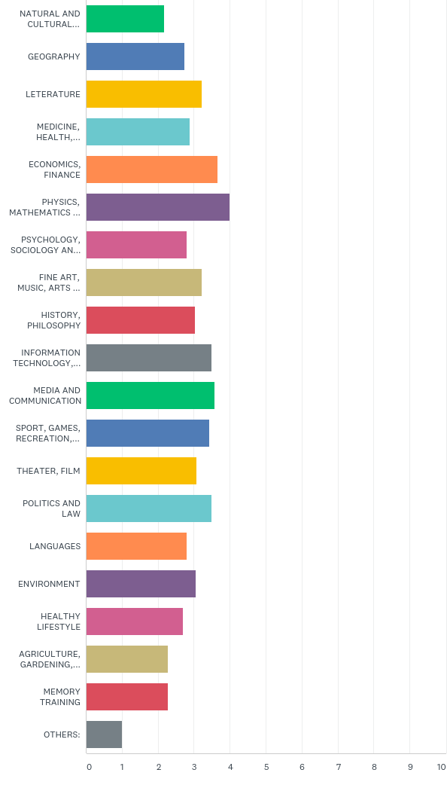
Q12: WHICH TOPIC IS INTERESTING FOR YOU
Responderam: 150 Ignoraram: 0

Slide 15
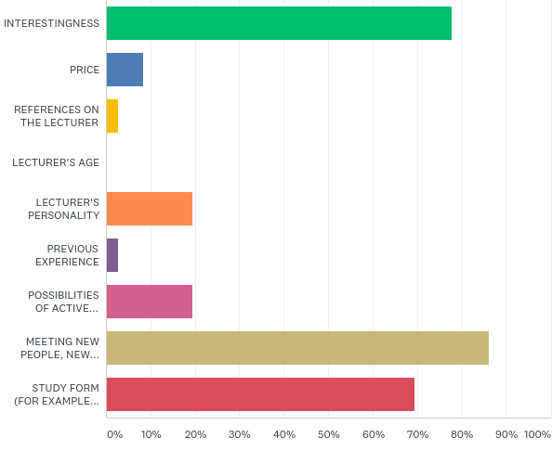
Q13: WHAT IS IMPORTANT FOR YOU WHEN CHOOSING A U3A COURSE? CHOOSE THREE OPTIONS
Responderam: 150 Ignoraram: 0

Slide 16
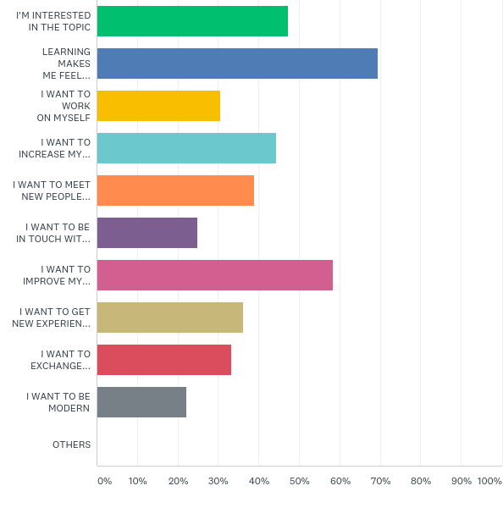
Q14: WHAT ARE THE REASONS THAT YOU WANT TO LEARN SOMETHING NEW?
Responderam: 150 Ignoraram: 0

Slide 17
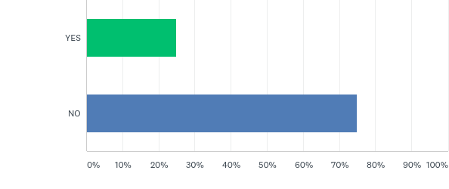
Q15: CAN YOU IMAGINE THET YOU WOULD ACTIVELY PARTICIPATE IN EDUCATION?(CREATE/PLAN/ORGANIZE/TEACH OWN COURSES)
Responderam: 150 Ignoraram: 0

Slide 18
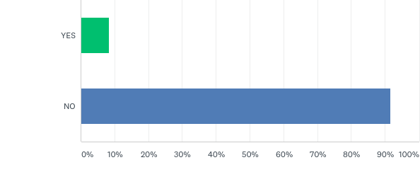
Q16: DO YOU MISS A POSSIBILITY TO REALIZE YOUR POTENTIAL IN ORGANIZING EDUCATIONAL ACTIVITIES
Responderam: 150 Ignoraram: 0

Slide 19
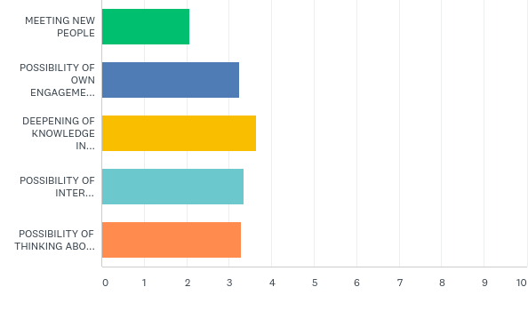
Q17: WHAT DESCRIBES BEST YOUR MOTIVATION TO EDUCATION IN U3A
Responderam: 150 Ignoraram: 0

Slide 20
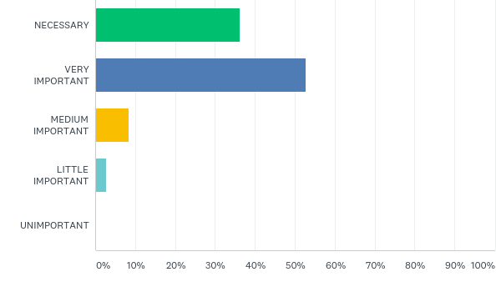
Q18: HOW DO YOU EVALUATE THE POSSIBILITY TO STUDY IN U3A FOR YOUR QUALITY OF LIFE
Responderam: 150 Ignoraram: 0

